Slide 1
Tendências da esperança de vida
DEMOGRAFIA

Slide 2
(1) Longevidade

Slide 3
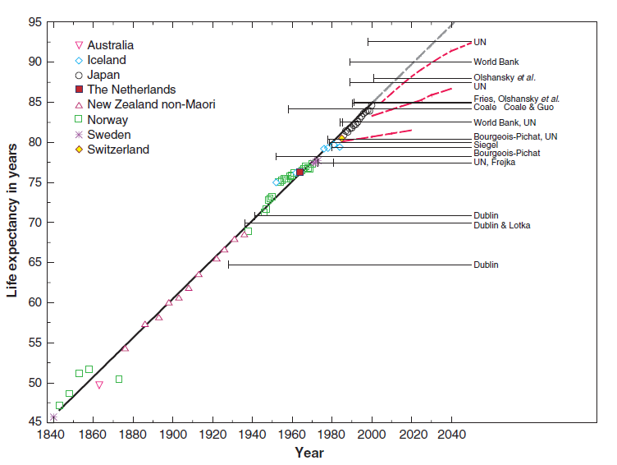
Fig. 1. Record female life expectancy from 1840 to the present

Slide 4
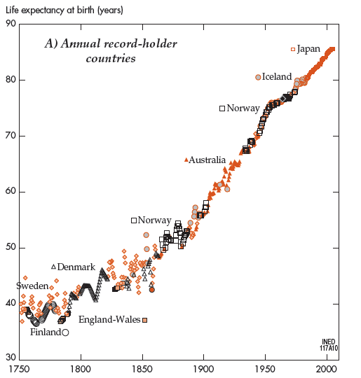

Slide 5
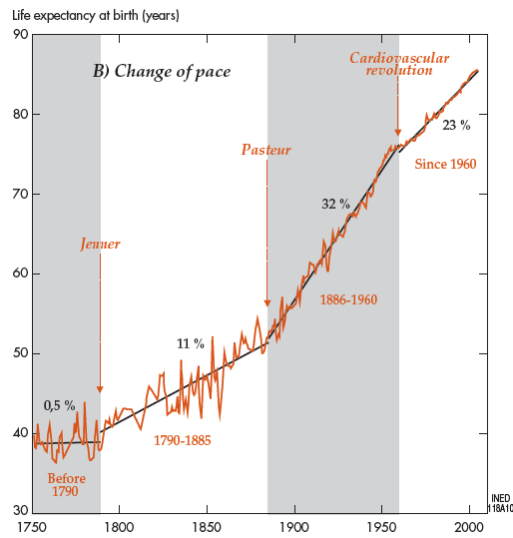

Slide 6
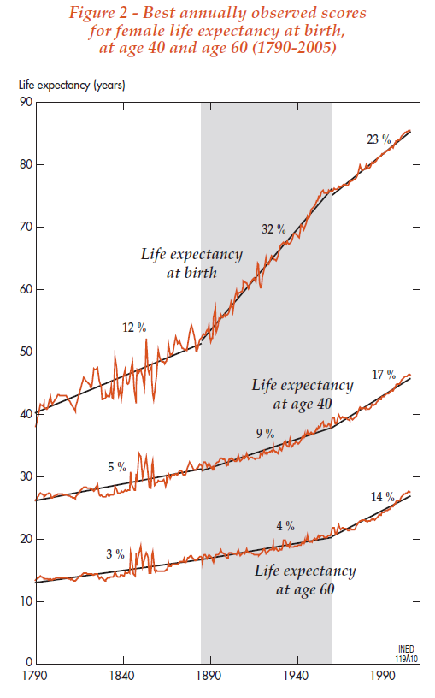

Slide 7
Fontes:
Oeppen, Jim e James W. Vaupel (2002), “Broken limits to life expectancy”, Science, Vol. 296, May 2002
Vallin, Jacques e France Meslé (2010), “Ésperance de vie: peut-on gagner trois mois par an indéfiniment?”, Populations et Societés, 473, Décembre 2010

Slide 8
(2) Diferença da esperança de vida entre os sexos

Slide 10
Fontes:
France Meslé (2004), “Life expectancy: a female advantage under threat?”, Population & Societies, 402, June 2004.
United Nations, World Population Prospects - the 2010 Revision

